Slide 1

Institution Of Data Mini Project 1
8 July 2020
Ricky K Nguyen

Slide 2
Business question
Is Sydney temperature increase over the year?

Slide 3
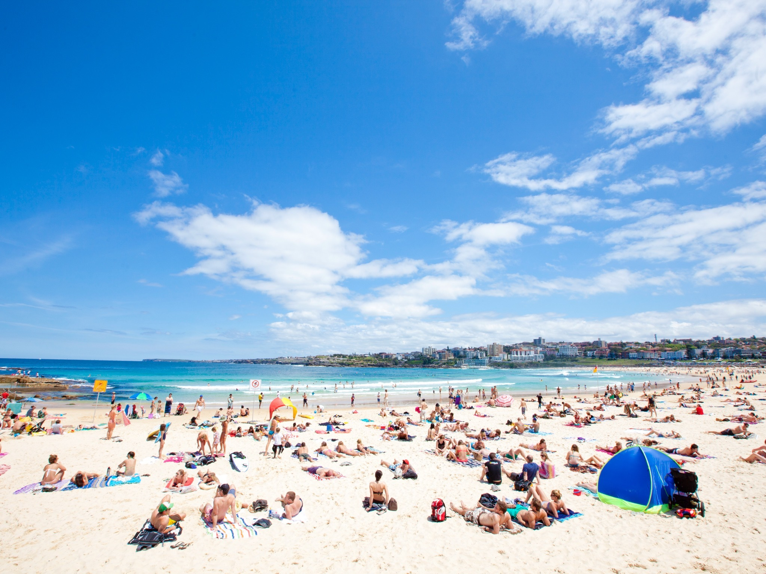
Why ask this question
Australia’s tourism is weather dependent
Tourism is the nation’s second-largest export industry
Valued at $40 billion
Employed 580,000 people
Extreme temperature will affect:
Beaches
Natural wonders
Hotel
Restaurant

Slide 4
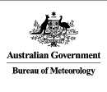
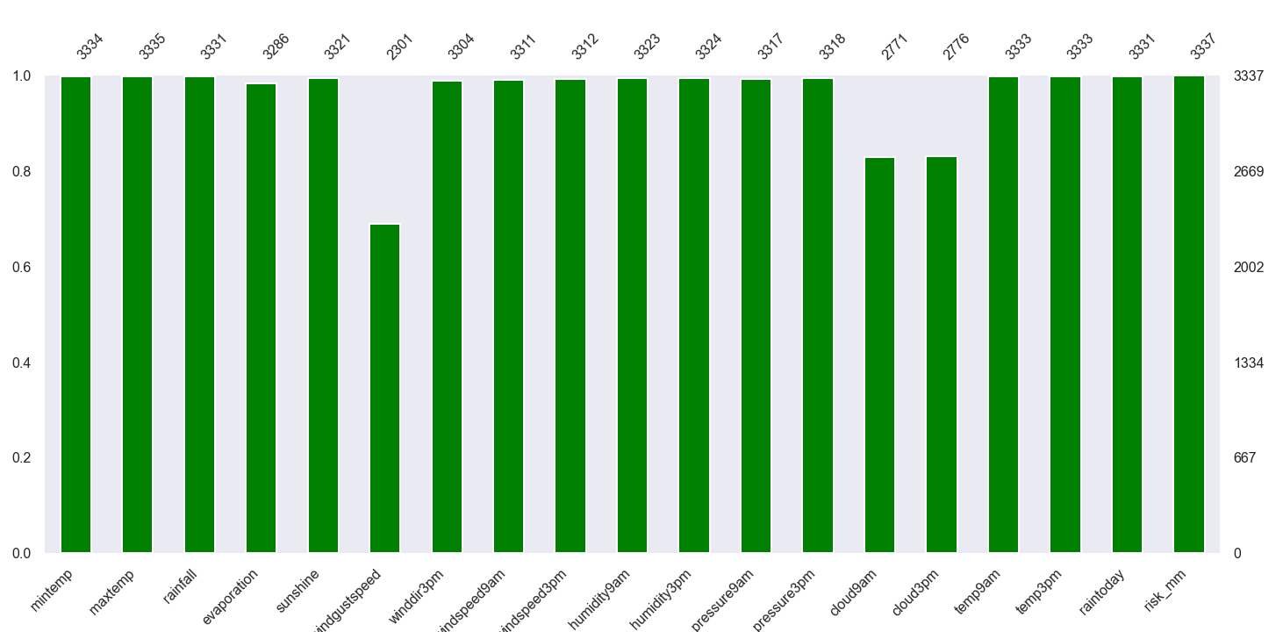
Dataset
Australia Bureau of Meteorology
3337 observations
Range 2008 -2017
Features
Minimum
Maximum
Missing Data Graph
Frequency
Features

Slide 5
pipeline
Data
Acquisition
Clean &
Exploring
Visualization
Hypothesize
Build Models

Slide 6
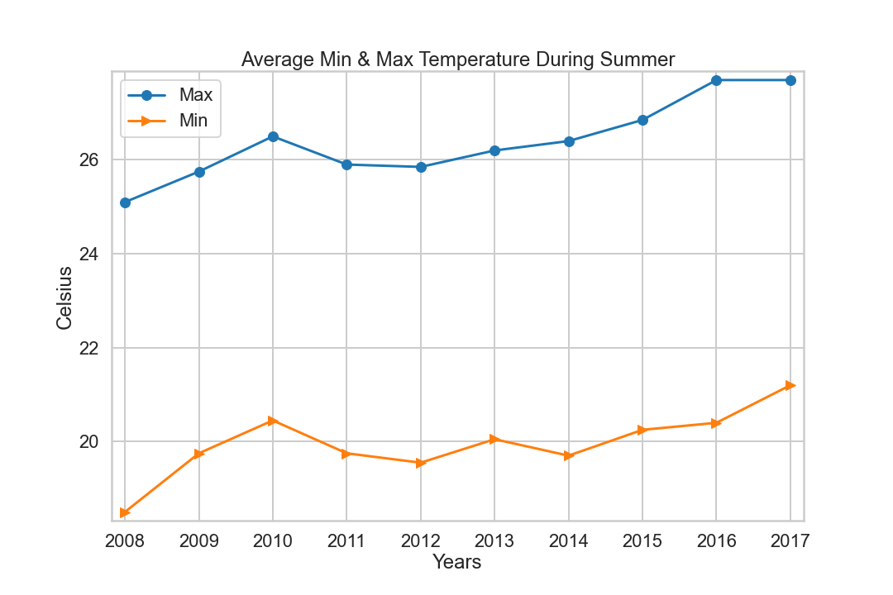
dataset

Slide 7
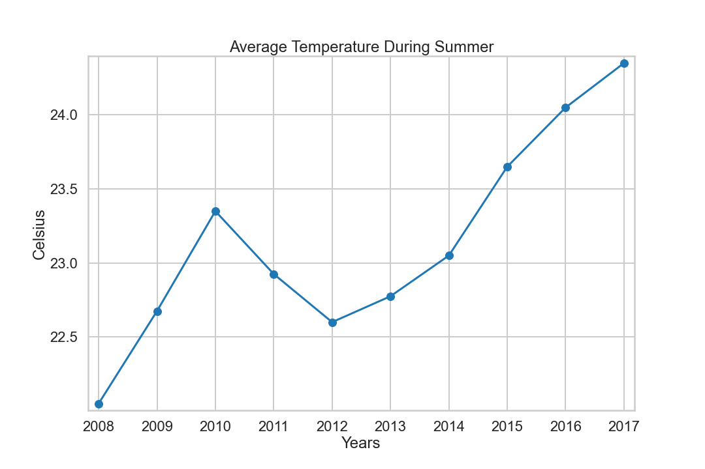
Dataset – Cont.

Slide 8

Hypothesis
H0: no different between data A& data B.
H1: there is difference between our dataset.
Significance level: 5%
Permutation replicates: 0.5%
Z-test: 4.75%
Conclusion:
Sydney temperature is increasing over the year

Slide 9
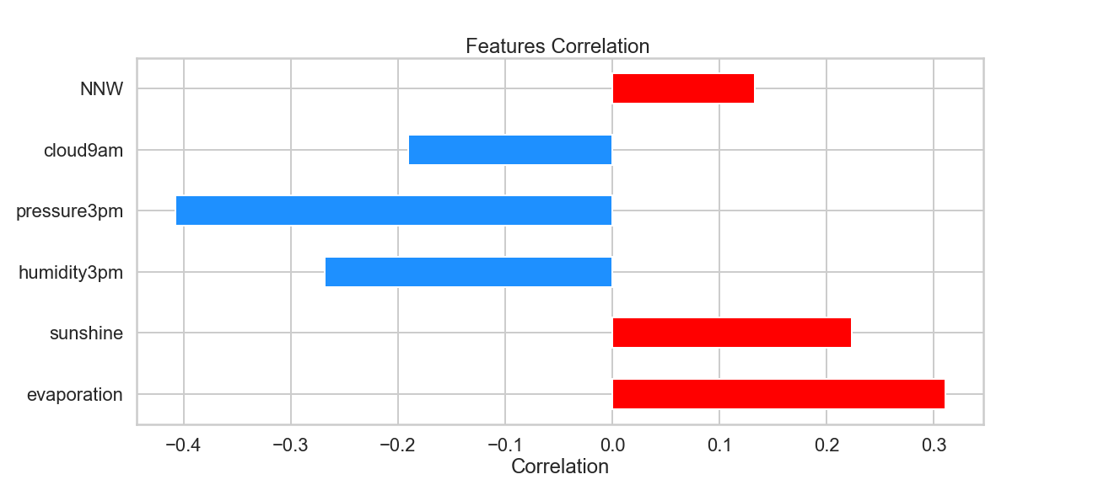
Key findings
Hotter: increases in evaporation, sun duration
Colder: increases in humidity, atmosphere pressure, cloud formation density
NNW winds tend to increase temperature in Sydney

Slide 10
Further improvements
Additional data
Wind speed & direction
Global warming data
Carbon dioxide data

